Slide 1

EE150 Signals and Systems
Tutorial 13
Xiaopeng Yu (余肖鹏）
ShanghaiTech University
June 2024
Tutorial 13
EE 150
June 2024

Slide 2
Outline
Outline
From Fourier to Laplace
Region of Convergence
Inverse LT
Block Diagram of LT
Tutorial 13
EE 150
June 2024

Slide 3
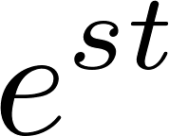
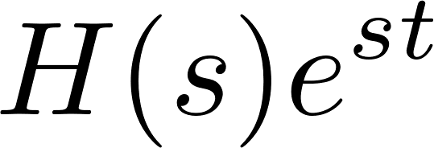
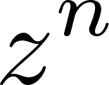
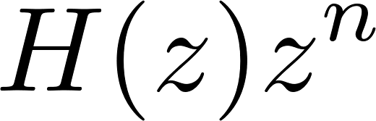
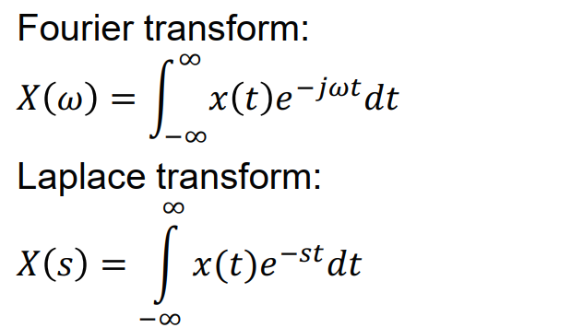
From Fourier to Laplace
The response of LTI system to complex exponentials
Continuous time:
Discrete time:
Tutorial 13
EE 150
June 2024

Slide 4
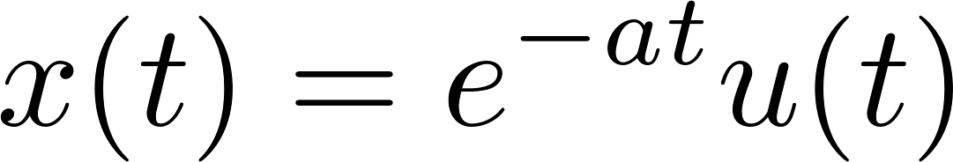
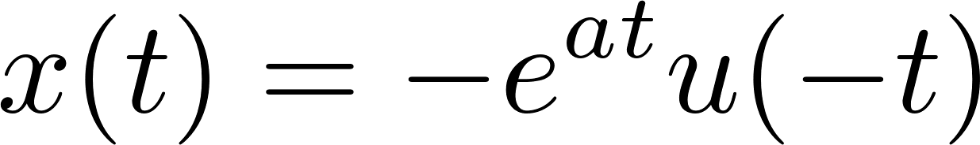
From Fourier to Laplace
Find the Fourier and Laplace transform of following signal:
Is it true that ?
Example: unit step function
Tutorial 13
EE 150
June 2024

Slide 5
From Fourier to Laplace
Laplace and Fourier
Laplace:
Usually unilateral
Defined also when Fourier transform does not exist
More useful for system transient behavior and for stability
Fourier:
Usually bilateral
Usually used for signal analysis and filter design
More intuitive
Tutorial 13
EE 150
June 2024

Slide 6
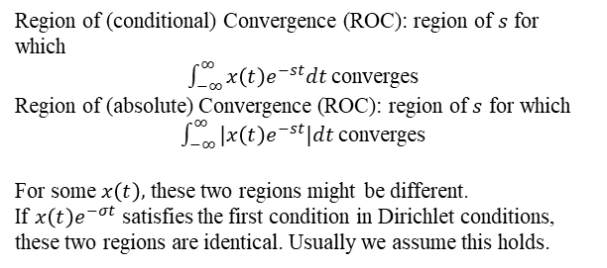
Region of Convergence (ROC)
Region of Convergence
Region of (conditional) Convergence (ROC): region of $s$ for which
$\int_{−∞}^{∞}{x\left(t\right)e^{−st}dt}$ converges
Region of (absolute) Convergence (ROC): region of $s$ for which
$\int_{−∞}^{∞}{|x\left(t\right)e^{−st}|dt}$ converges
For some $x\left(t\right),$ these two regions might be different.
If $x\left(t\right)e^{−σt}$ satisfies the first condition in Dirichlet conditions, these two regions are identical. Usually we assume this holds.
Tutorial 13
EE 150
June 2024

Slide 7
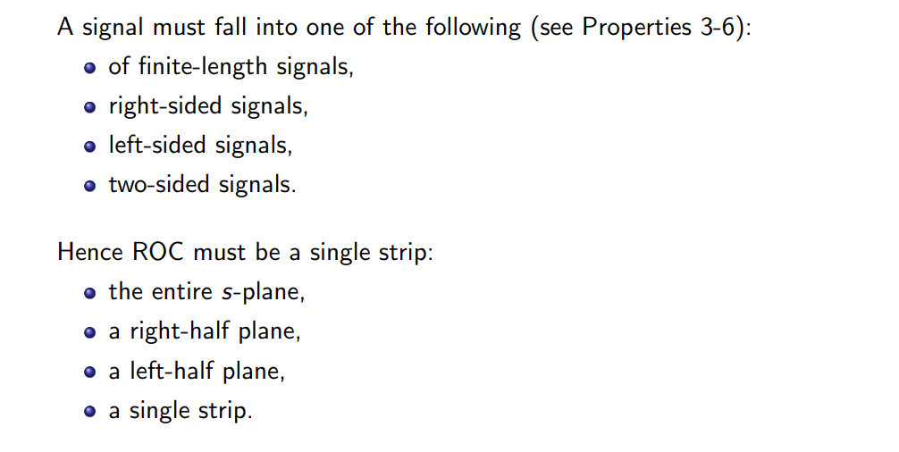
Region of Convergence (ROC)
ROC Property
Tutorial 13
EE 150
June 2024

Slide 8
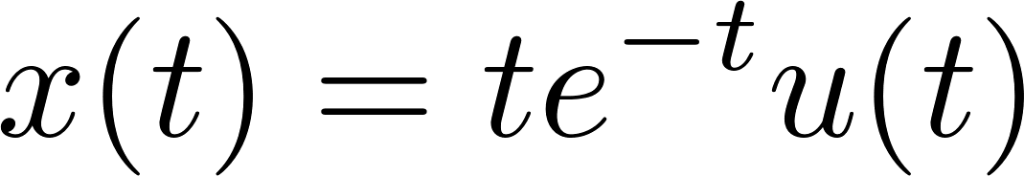
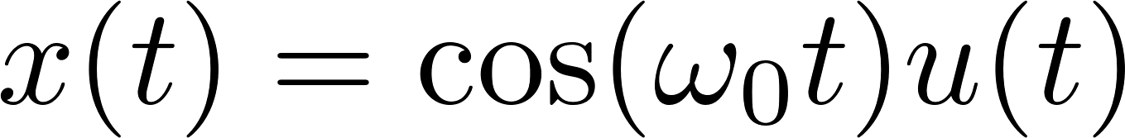
Region of Convergence (ROC)
Find the Laplace transform of following signals:
Tutorial 13
EE 150
June 2024

Slide 9
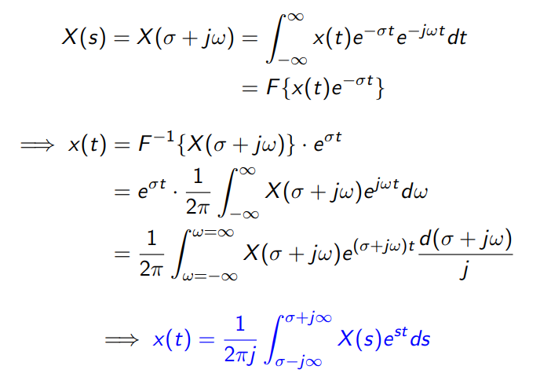
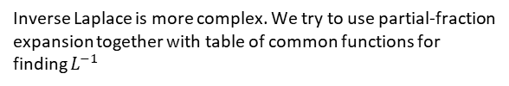
Inverse LT
Inverse Laplace is more complex. We try to use partial-fraction expansion together with table of common functions for finding $L^{−1}$
Tutorial 13
EE 150
June 2024

Slide 10
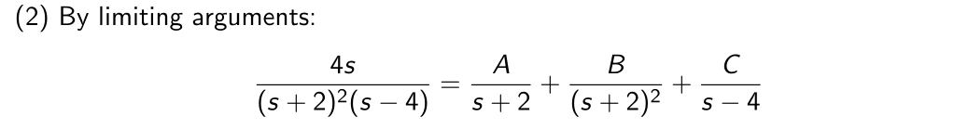
Inverse LT
Rational LT
Tutorial 13
EE 150
June 2024

Slide 11

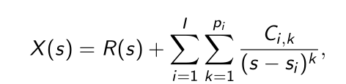
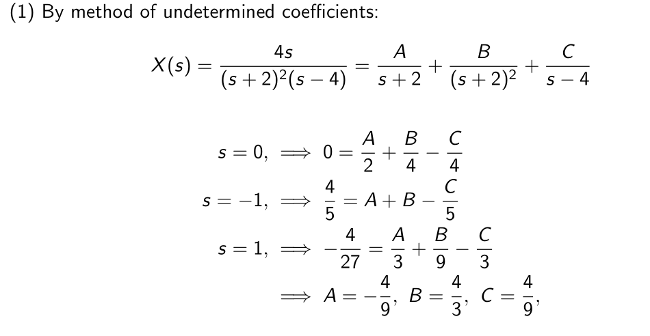
Inverse LT
Rational LT
Tutorial 13
EE 150
June 2024

Slide 12
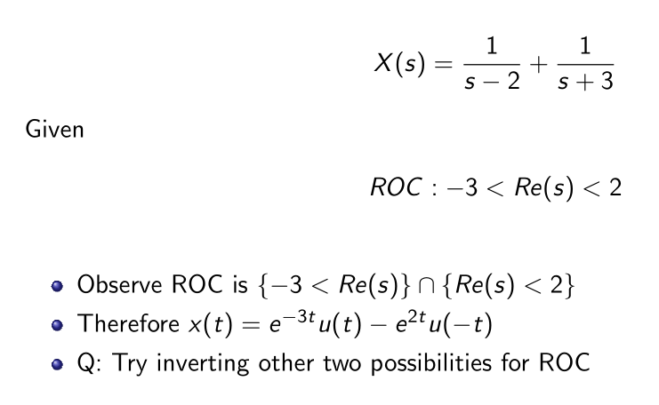
Inverse LT
Example
Tutorial 13
EE 150
June 2024

Slide 13
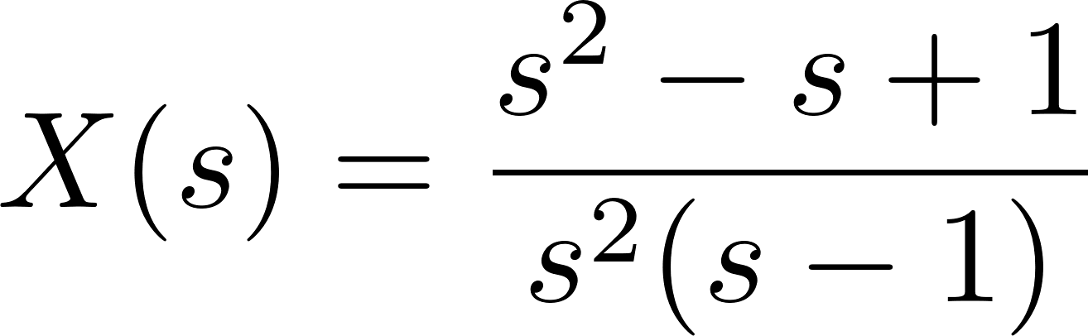
Inverse LT
Example: Determine the time-domain x(t)
0 < Re{s} < 1
Tutorial 13
EE 150
June 2024

Slide 14
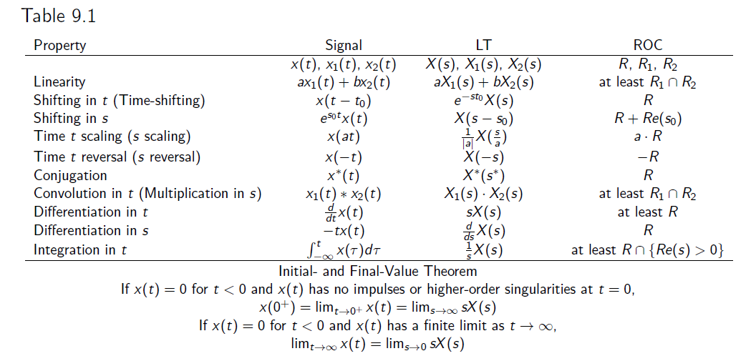
Inverse LT
Properties of LT:
Tutorial 13
EE 150
June 2024

Slide 15
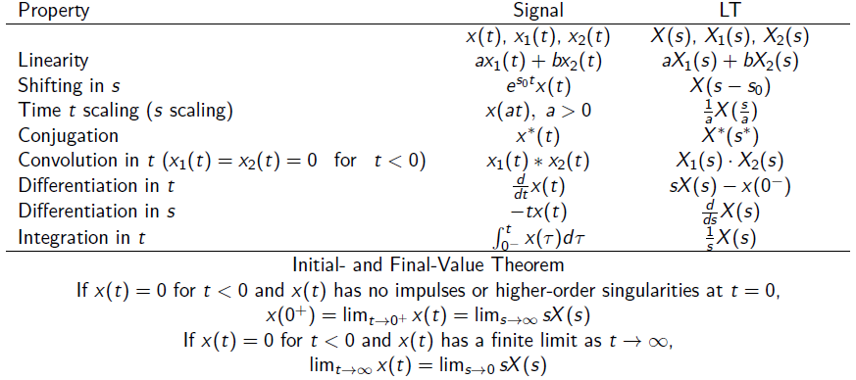
Inverse LT
Properties of LT:
Tutorial 13
EE 150
June 2024

Slide 16
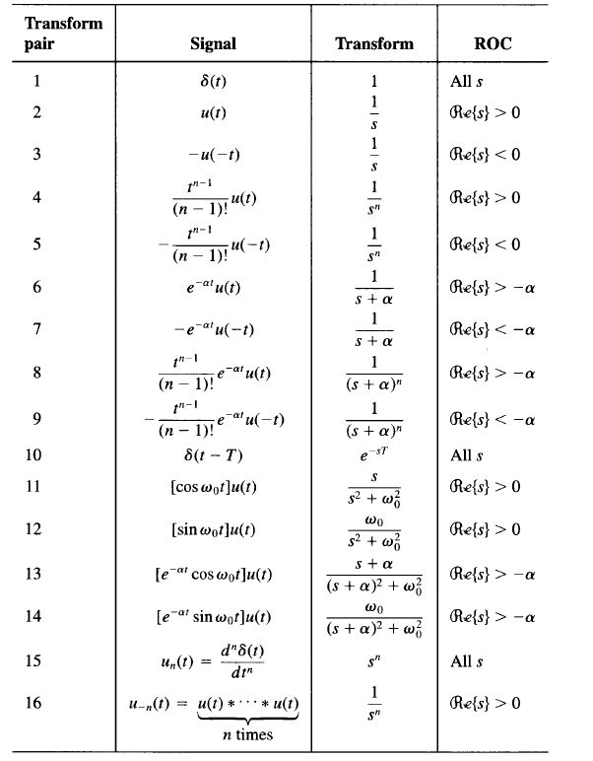
Inverse LT
Properties of LT:
Tutorial 13
EE 150
June 2024

Slide 17
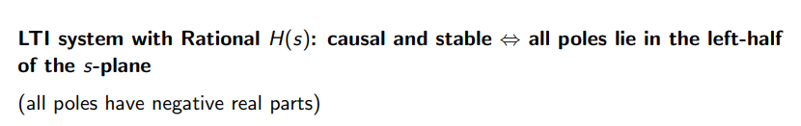
Block Diagram
LTI system
Tutorial 13
EE 150
June 2024

Slide 18
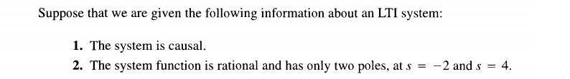
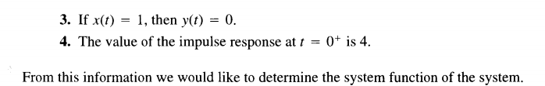
Block Diagram
Example:
Tutorial 13
EE 150
June 2024

Slide 19
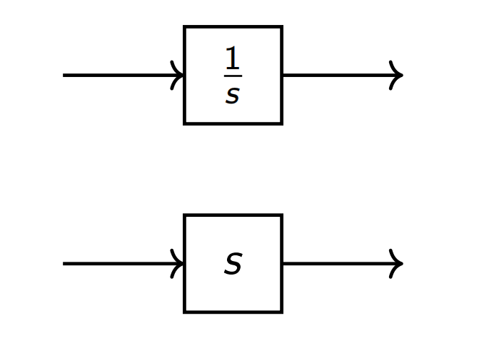

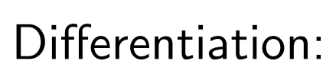
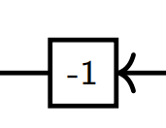
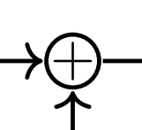
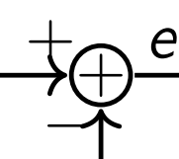
Block Diagram
Possible circuits
Mutiply constant:
Add:
Tutorial 13
EE 150
June 2024

Slide 20
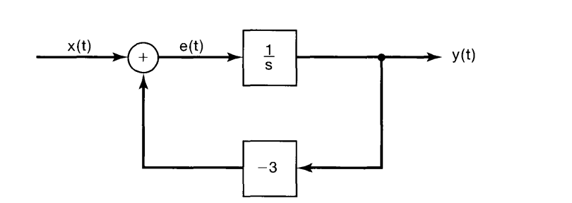
Block Diagram
Find the system response of following block:
Tutorial 13
EE 150
June 2024

Slide 21

Block Diagram
Find the block diagram of:
Tutorial 13
EE 150
June 2024

Slide 22
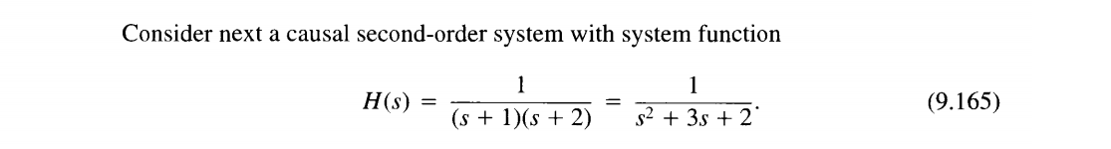
Block Diagram
Find the block diagram of:
Tutorial 13
EE 150
June 2024

